Slide 1
Beam
A structural member which is long when compared with its lateral dimensions, subjected to transverse forces so applied as to induce bending of the member in an axial plane, is called a beam.

Slide 2
W₁
90◦
A
B

Slide 3
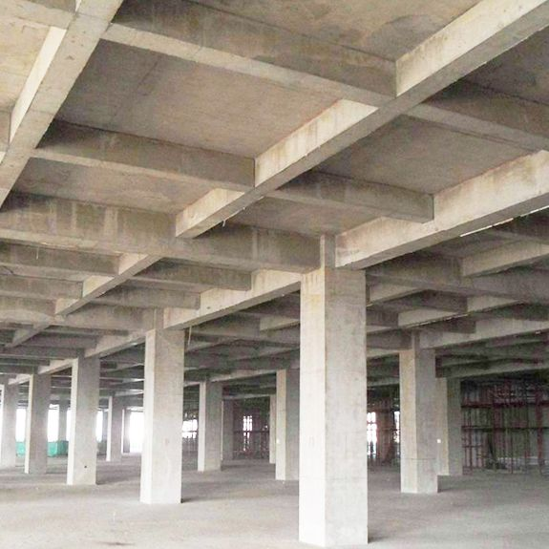
beam

Slide 4
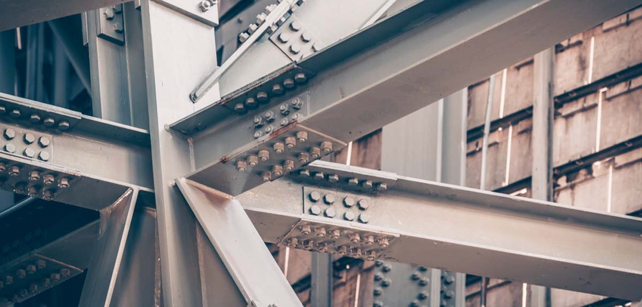

Slide 5
Types of supports

Slide 6
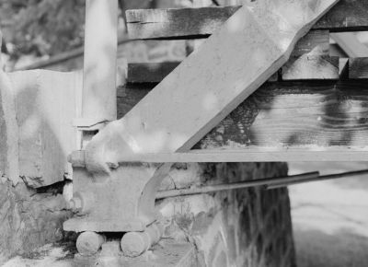
Roller support

Slide 7
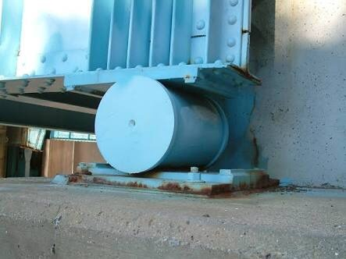
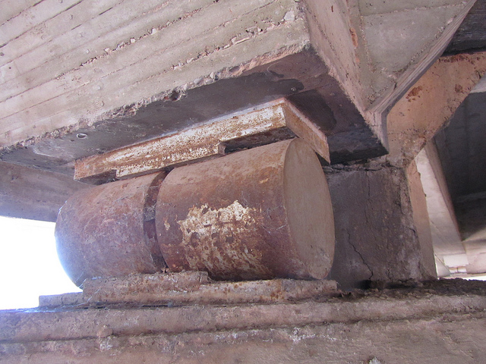
Roller support

Slide 8
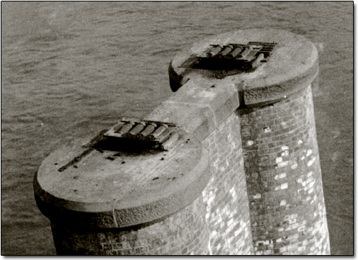
Roller support

Slide 9
Types of supports

Slide 10

W₁
H_{A}
30◦
A
B
^{α}
Hinge support
R_{A}
Roller support
V_{A}
V_{B}

Slide 11
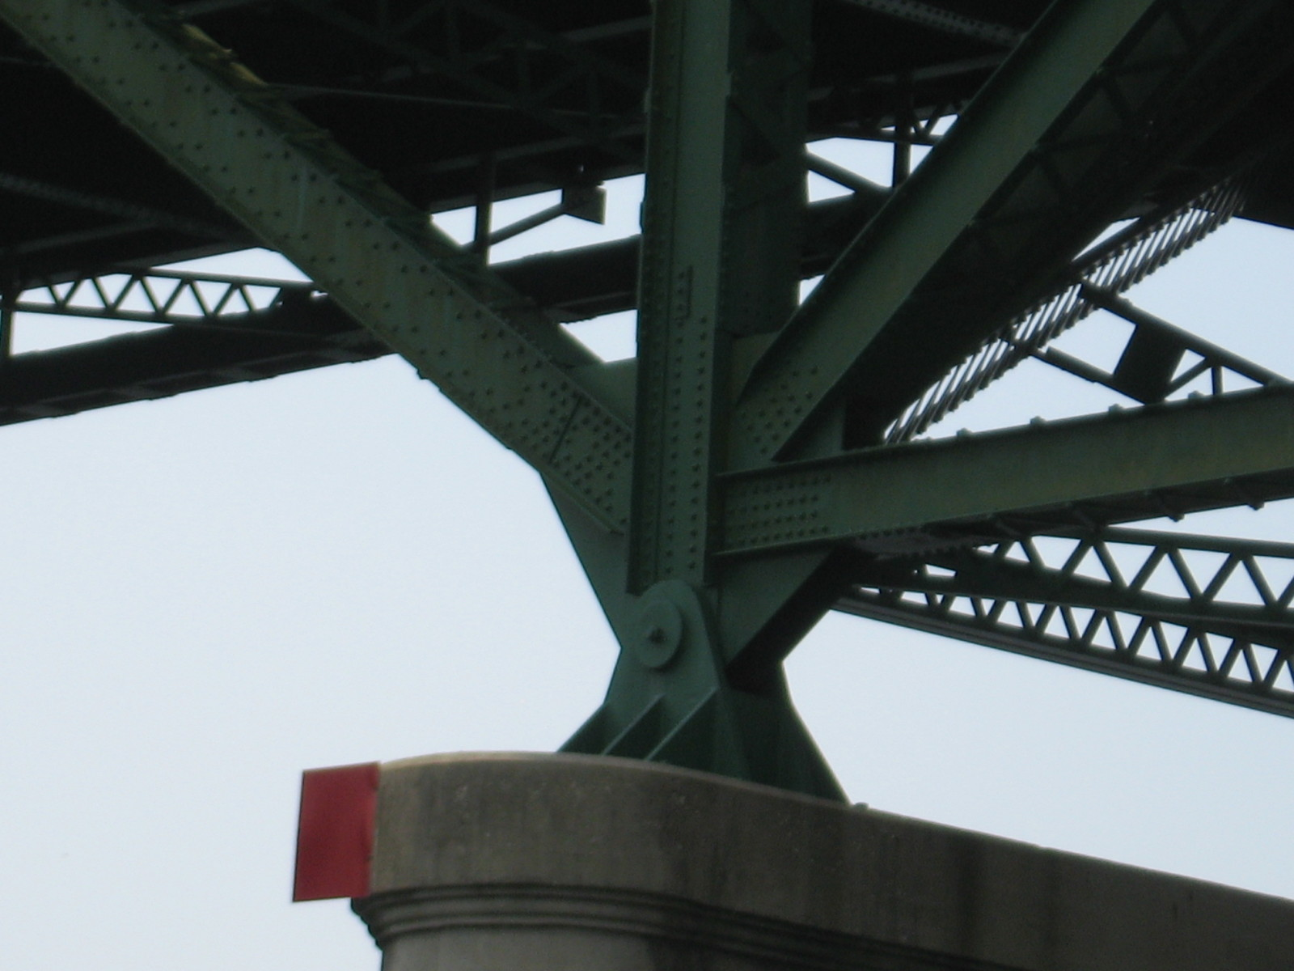

Slide 12
Types of supports

Slide 13
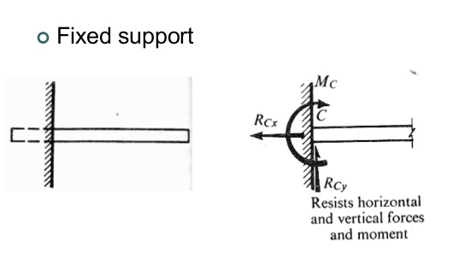
Types of supports

Slide 14
beam
Fixed

Slide 15
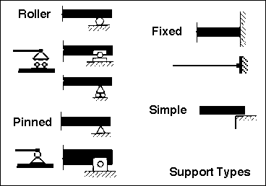
Types of supports

Slide 16
TYPES OF BEAMS
Simply Supported Beam
Over-hanging Beam
Cantilever Beam
Propped Cantilever
Continuous Beam
Fixed beam

Slide 17
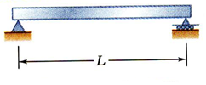
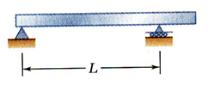
Types of beams
1.Simply supported beam:-
A beam supported freely on the walls or columns at its both ends is known as simply supported beam.
2.Over hanging beam:-
A Beam is freely supported on two supports. But its one end or both the ends are projected beyond the support.

Slide 18
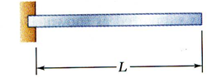
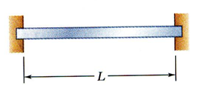
Types of beams
3.Cantilever Beam:
A Beam Fixed at one end and free at the other end is known as cantilever Beam.
4.Fixed Beam:-
A beam whose both ends are rigidly fixed is known as cantilever beam.

Slide 19
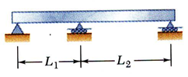
Types of beams
5.Continuous beam:-
A Beam Supported on more then two support is known as continuous beam.

Slide 20
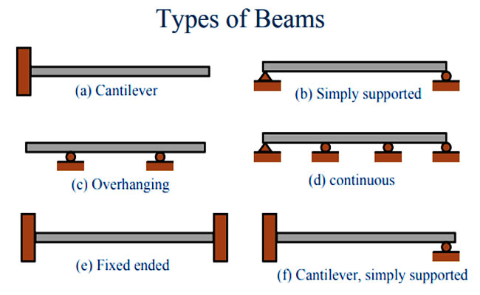
Propped Cantilever

Slide 21
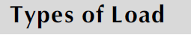
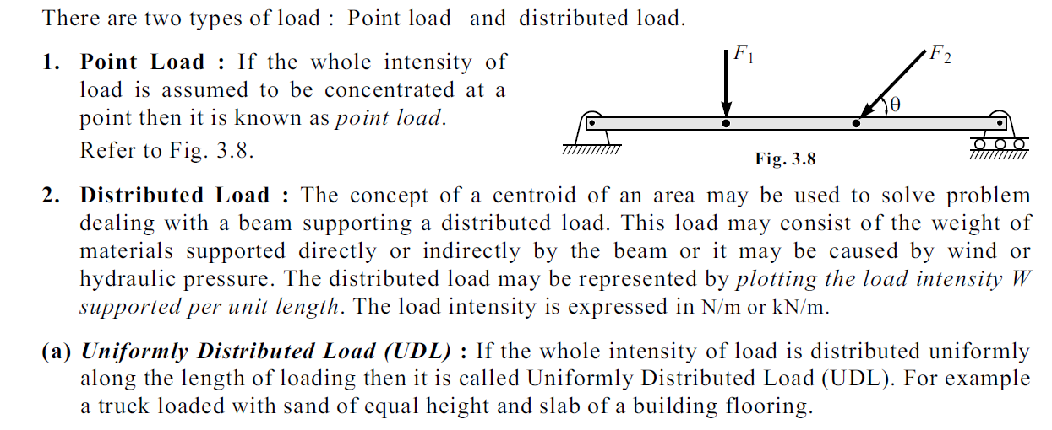

Slide 22
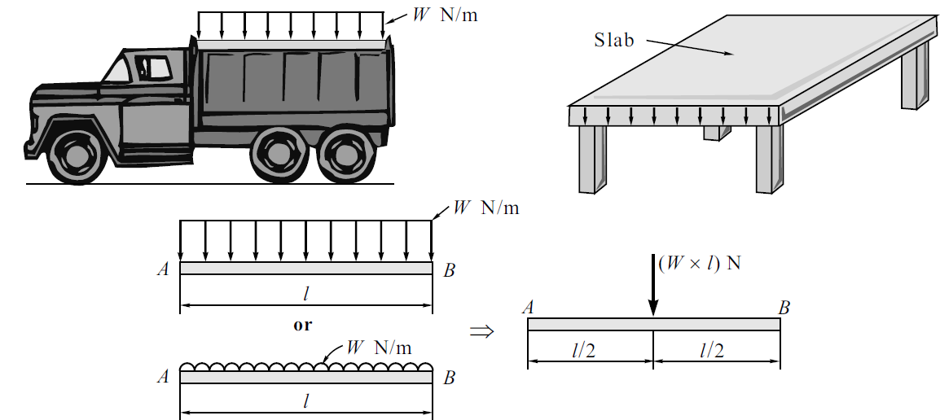

Slide 23
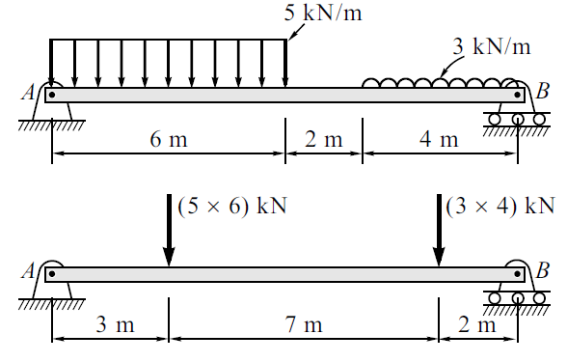

Slide 24
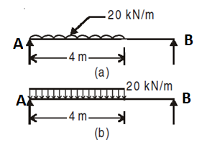
TYPES OF LOADING
Uniformly Distributed Load (UDL): Over considerably long distance such load has got uniform intensity. It is represented as shown in Fig. (a) or as in (b). For finding reaction, this load may be assumed as total load acting at the centre of gravity of the loading (middle of the loaded length).

Slide 25
TYPES OF LOADING
_{b}
_{d}
_{l}
_{RCC unit wt = 25 kN/m}³
b = 0.23 m,
d= 0.45 m,
load intensity = 25 x 0.23 x 0.45 = 2.5875 kN/m
w = 2.5875 kN/m

Slide 26
UDL in equivalent point load
_{2.5875 kN/m}
_{A}
_{B}
_{4 m}
_{2.5875 x 4 = 10.35 kN}
_{A}
_{B}
_{2 m}
_{4 m}

Slide 27
UDL in equivalent point load
_{3 kN/m}
_{A}
_{B}
_{C}
_{2.5 m}
_{4 m}
_{3x 2.5 = 7.5 kN}
_{A}
_{B}
_{1.25m}
_{4 m}

Slide 28
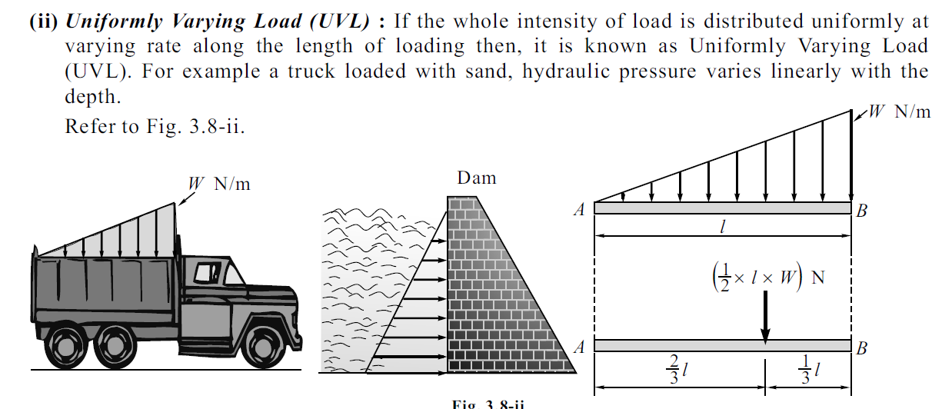

Slide 29
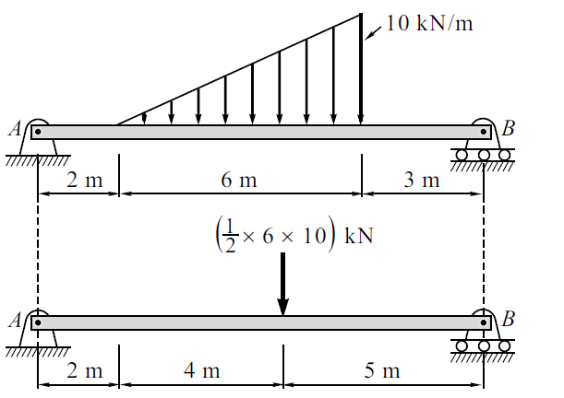

Slide 30
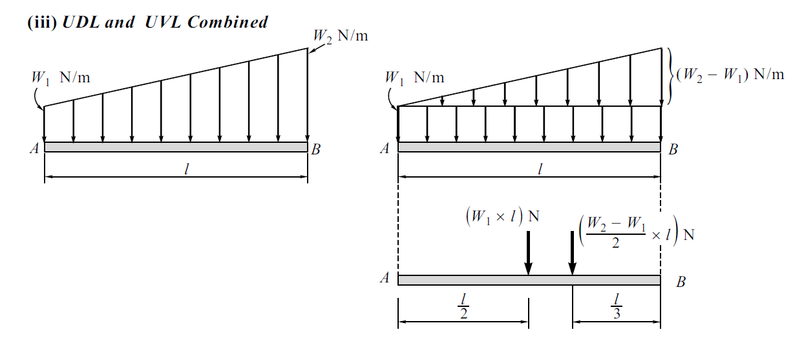

Slide 31
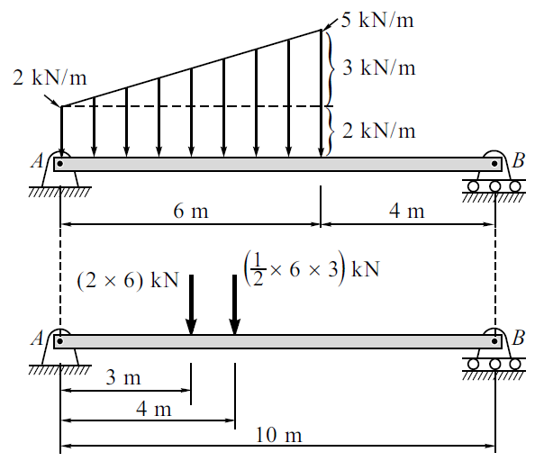

Slide 32
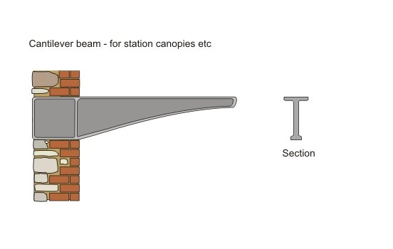
_{b}
_{d2}
_{d1}
_{B}
_{A}
_{l}
_{W2} _{per unit length}
_{W1} _{per unit length}
_{A}
_{B}
_{l}

Slide 33
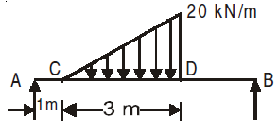
_{0.5 x 20 x 3 =30 kN}
_{2 x 3/3 = 2m}
_{3/3 = 1 m}

Slide 34
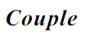
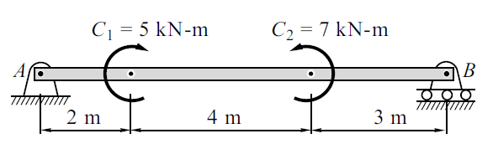
External Moment: A beam may be subjected to external moment at certain points. In Fig. the beam is subjected to clockwise moment of 30 kN-m at a distance of 2 m from the left support.
has no significance as far as
position is concerned.

Slide 35
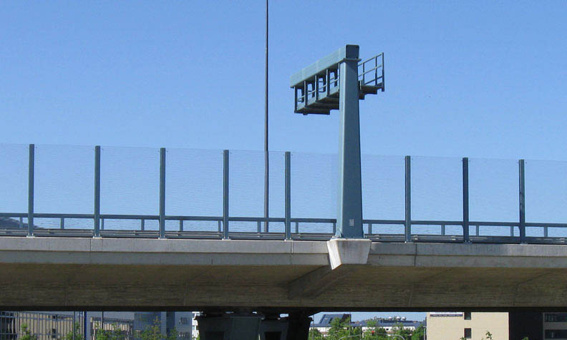

Slide 36
Beam
Determinate beams
Indeterminate beams
Beams with maximum 3 unknowns is know as determinate beams.
Example:- simply supported beam, cantilever, overhanging beam, roller beam
Beams with more than 3 unknowns is know as Indeterminate beams.
Examples:- Fix beam , propped cantilever beam , continuous beam

Slide 37
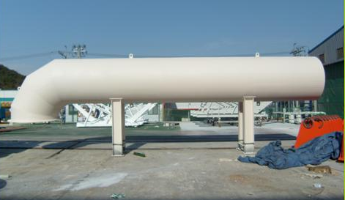
_{wt. of fluid}
_{Self wt of pipe}

Slide 38
Determine support reactions for following beams
Find the reactions at supports A and B of the loaded beam shown in Fig.

Slide 39
40 kN
Example 1
A
C
B
2 m
4 m
V_{B}
V_{A}
ΣFx = 0 , ΣFy = 0, ΣM = 0
ΣFy = 0 (upward forces + ve)
V_{A} – 40 + V_{B} = 0, V_{A} + V_{B} = 40 kN
ΣM_{A} = 0 (anticlockwise moment +ve)
(40 x 2) + (V_{B} x 6 ) = 0
V_{B} = 80/6 = 13.67 kN
V_{A} =40 – 13.67 = 26.33 kN

Slide 40
Example 2
_{10 x 6 = 60 kN}
_{10 kN/m}
_{A}
_{B}
_{3 m}
_{6 m}
V_{A}
V_{B}
ΣFx = 0 , ΣFy = 0, ΣM = 0
ΣFy = 0 (upward forces + ve)
V_{A} – (60) + V_{B} = 0, V_{A} + V_{B} = 60 kN
ΣM_{A} = 0 (anticlockwise moment +ve)
[(60 x (6/2)] + (V_{B} x 6 ) = 0
V_{B} = 180/6 = 30 kN
V_{A} = 60 - 30 = 30 kN

Slide 41
_{3 kN/m}
Example 3
_{A}
_{B}
_{C}
_{4m}
_{3x 4 = 12 kN}
_{6 m}
_{A}
_{B}
_{2 m}
_{6m}
V_{A}
V_{B}
ΣFy = 0 (upward forces + ve)
V_{A} – (12) + V_{B} = 0, V_{A} + V_{B} = 12 kN
ΣM_{A} = 0 (anticlockwise moment +ve)
(12 x 2) + (V_{B} x 6 ) = 0
V_{B} = 24/6 = 4 kN
V_{A} = 12 – 4 = 8 kN

Slide 42
_{3 kN/m}
_{10 kN}
Example 4
_{C}
_{D}
_{A}
_{B}
_{4m}
_{1 m}
_{3x 4 = 12 kN}
_{6 m}
_{10 kN}
_{C}
_{D}
_{A}
_{B}
_{2 m}
_{2 m}
_{1 m}
V_{A}
_{6m}
V_{B}
ΣFy = 0 (upward forces + ve)
V_{A} – 12 - 10 + V_{B} = 0, V_{A} + V_{B} = 22 kN
ΣM_{A} = 0 (anticlockwise moment +ve)
(12 x 2) – (10 x 5) + (V_{B} x 6 ) = 0
V_{B} = (24+50)/6 = 74/6 = 12.33 kN
V_{A} = 22 – 12.33 = 9.67 kN

Slide 43
Example 5
_{20 kN/m}
_{0 kN/m}
_{A}
_{6 m}
_{B}
_{0.5 x 20 x 6 = 60 kN}
_{A}
_{B}
_{6/3 = 2 m}
_{6m}
V_{B}
V_{A}
ΣFy = 0 (upward forces + ve)
V_{A} – 60 + V_{B} = 0, V_{A} + V_{B} = 60 kN
ΣM_{A} = 0 (anticlockwise moment +ve)
(60 x 2) + (V_{B} x 6 ) = 0
V_{B} = 120/6 = 20 kN
V_{A} = 60 – 20 = 40 kN

Slide 44
W₁
H_{A}
30◦
A
B
^{α}
Hinge support
R_{A}
Roller support
V_{A}
V_{B}

Slide 45
_{3 kN/m}
_{10 kN}
Example 6
_{C}
_{D}
₃₀◦
_{A}
_{B}
_{4m}
_{1 m}
_{3x 4 = 12 kN}
_{6 m}
_{10 sin30 = 5 kN}
_{C}
_{D}
_{10 cos30 =8.66 kN}
H_{A}
_{B}
_{A}
_{2 m}
_{2 m}
_{1 m}
V_{A}
_{6m}
V_{B}
ΣFx = 0 (forces moving towards right side + ve)
H_{A} – 8.66 = 0, H_{A} = 8.66 kN
ΣFy = 0 (upward forces + ve)
V_{A} – 12 - 5 + V_{B} = 0, V_{A} + V_{B} = 17 kN
ΣM_{A} = 0 (anticlockwise moment +ve)
(12 x 2) – (5 x 5) + (V_{B} x 6 ) = 0
V_{B} = (24+25)/6 = 49/6 = 8.167 kN
V_{A} = 17 – 8.167 = 8.83 kN

Slide 46
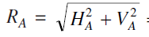
A
H_{A} = 8.66 kN
_{45.55}◦
R_{A}
V_{A} = 8.83 kN
R_{A}= 12.36 kN
tanα = V_{A}/ H_{A}= (8.83/8.66)
α= 45.55◦

Slide 47
Example 7
_{30 kN/m}
_{10 kN/m}
_{A}
_{B}
_{4 m}
_{0.5 x 20 x 4 =40 kN}
_{20 kN/m}
_{0 kN/m}
_{4/3 m}
_{10 x 4 = 40 kN}
_{10 kN/m}
_{10 kN/m}
_{4/2 m}

Slide 48
_{30 kN/m}
_{10 kN/m}
_{A}
_{B}
_{4 m}
_{40 kN}
_{40 kN}
_{4/3 m}
_{4/2 m}
V_{B}
V_{A}

Slide 49
_{40 kN}
_{40 kN}
_{4/3 m}
_{4/2 m}
_{4 m}
V_{B}
V_{A}
ΣFy = 0 (upward forces + ve)
V_{A} – 40 - 40 + V_{B} = 0, V_{A} + V_{B} = 80 kN
ΣM_{A} = 0 (anticlockwise moment +ve)
[40 x (4/3)] – [40 x (4/2)] + (V_{B} x 4 ) = 0
V_{B} = (53.2+80)/4 = 133.2/4 = 33.3 kN
V_{A} = 80 – 33.3 = 46.7 kN

Slide 50
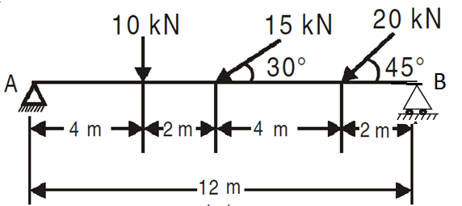
Unsolved Example 1
Find the reactions at supports A and B of the loaded beam shown in Fig.

Slide 51
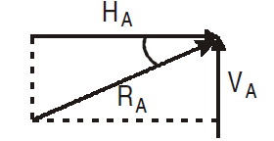
Unsolved Example 1
Find the reactions at supports A and B of the loaded beam shown in Fig.
H_{A} = 27.13 kN
V_{A} = 12.77 kN
V_{B} = 18.86 kN
R_{A} = 29.989 kN
α = 25.21◦

Slide 52
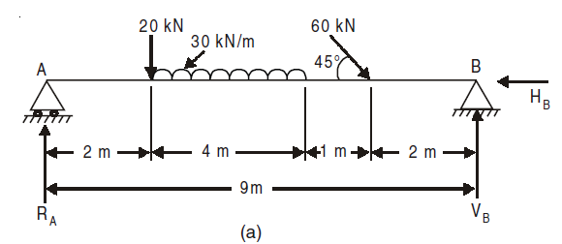
Unsolved Example 2
Find the reactions at supports A and B of the loaded beam shown in Fig.

Slide 53
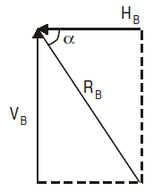
Unsolved Example 2
Find the reactions at supports A and B of the loaded beam shown in Fig.
V_{A} = 91.65 kN
V_{B} = 90.77 kN
H_{B} = 42.42 kN
R_{B} = 100.20 kN
α = 64.95◦

Slide 54
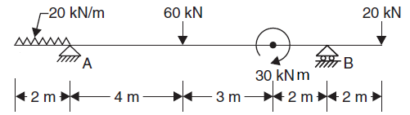
Unsolved Example 3
Find the reactions at supports A and B of the loaded beam shown in Fig.

Slide 55
Unsolved Example 3
Find the reactions at supports A and B of the loaded beam shown in Fig.
Moment not a force
V_{A}
V_{B}
ΣFy = 0 (upward forces + ve)
-(20 x 2) + V_{A}+ 60 + V_{B} + 20= 0, V_{A} + V_{B} = 120 kN
ΣM_{A} = 0 (anticlockwise moment +ve)
+[(20 x 2)x (2/2)] – (60 x 4)+ - 30 + (V_{B} x 9) – (20 x 11)= 0
V_{B} = (- 40+240 +30 +220)/9 = 450/9 = 50 kN
V_{A} = 120 – 50 = 70 kN

Slide 56
Unsolved Example 4
Find the reactions at supports A and B of the loaded beam shown in Fig.
_{4x4 =16 kN}
_{4 kN/m}
_{C}
_{B}
_{A}
_{2 m}
_{1 m}
_{1 m}
_{3 m}
ΣFy = 0 (upward forces + ve)
V_{A} – (4 x 4)+ V_{B} = 0, V_{A} + V_{B} = 16 kN
ΣM_{A} = 0 (anticlockwise moment +ve)
[(4 x 4) x 1] + (V_{B} x 3 ) = 0
V_{B} = (16)/3 = 5.33 kN
V_{A} = 16 – 5.33 = 10.67 kN

Slide 57
OR
Unsolved Example 4
_{4x4 =16 kN}
_{4 kN/m}
_{C}
_{B}
_{A}
_{2 m}
_{1 m}
_{1 m}
_{3 m}
ΣFy = 0 (upward forces + ve)
V_{A} – (4 x 4)+ V_{B} = 0, V_{A} + V_{B} = 16 kN
ΣM_{B} = 0 (anticlockwise moment +ve)
[(4 x 4) x 2] - (V_{A} x 3 ) = 0
V_{A} = (32)/3 = 10.67 kN
V_{B} = 16 – 10.67 = 5.33kN

Slide 58
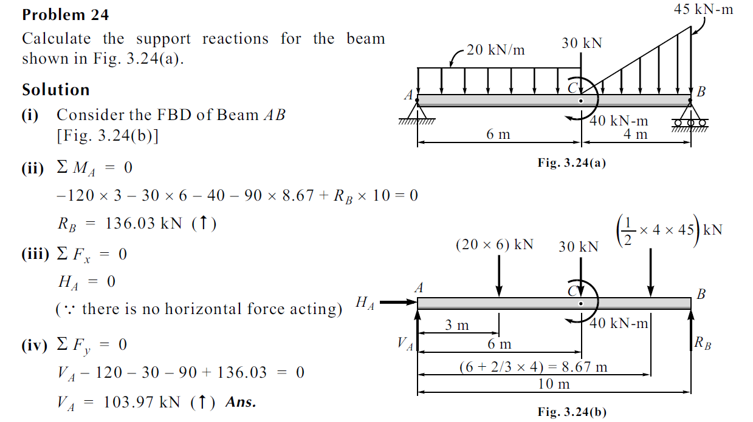

Slide 59
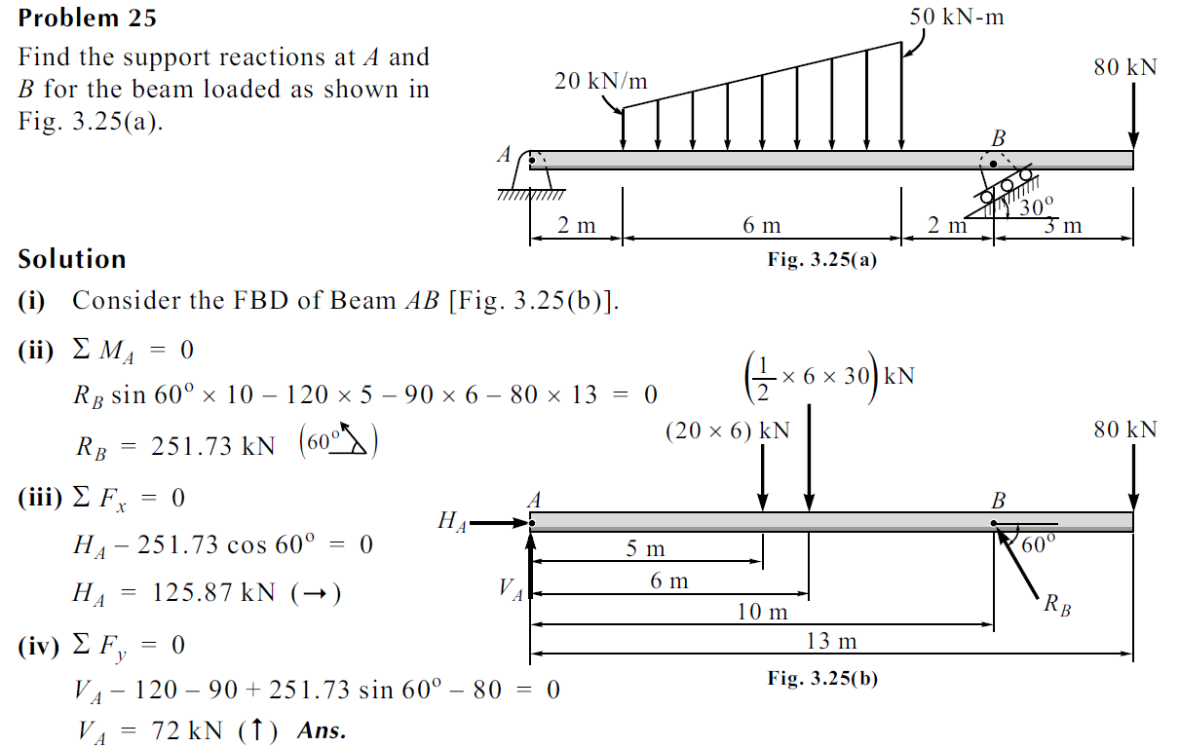

Slide 60
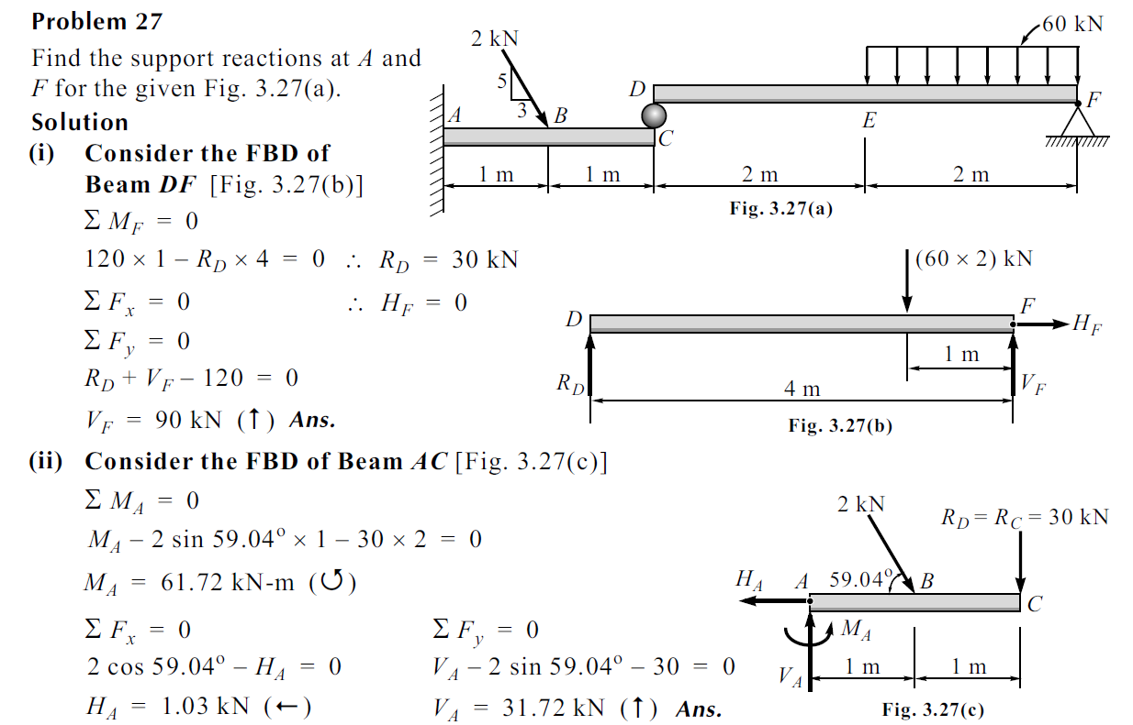

Slide 61
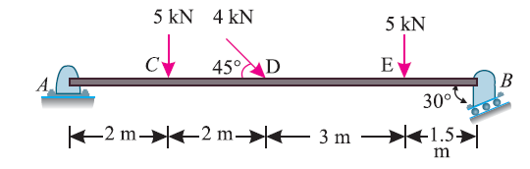
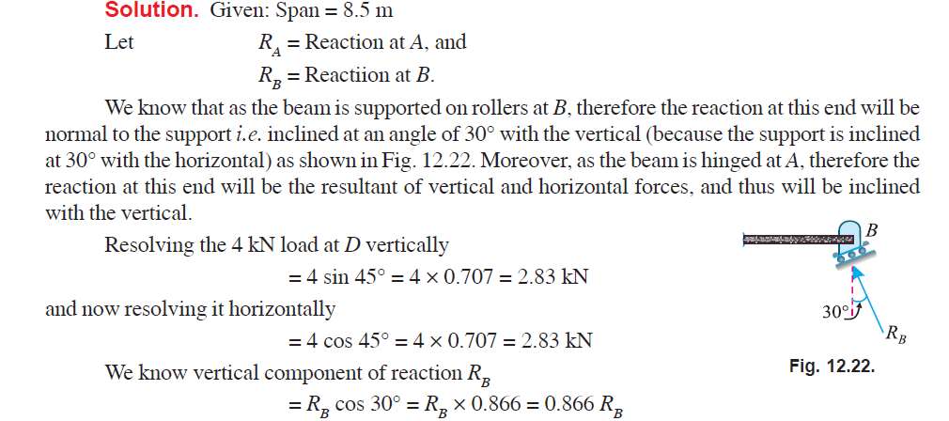
A beam AB 8.5 m long is hinged at A and supported on rollers over a smooth
surface inclined at 30° to the horizontal at B. The beam is loaded as shown in Fig

Slide 62
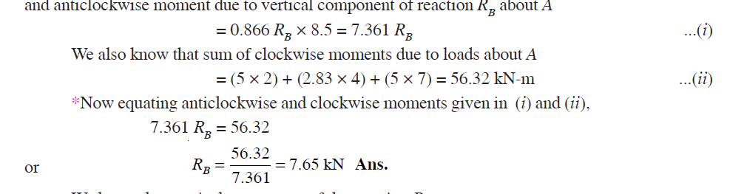
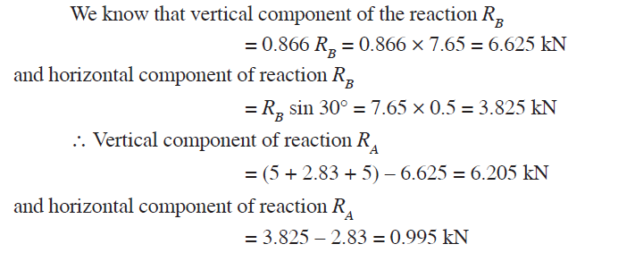

Slide 63
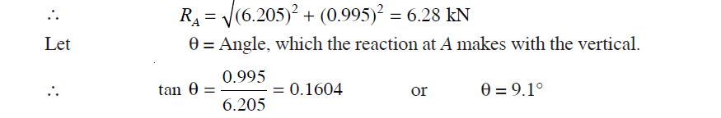

Slide 64
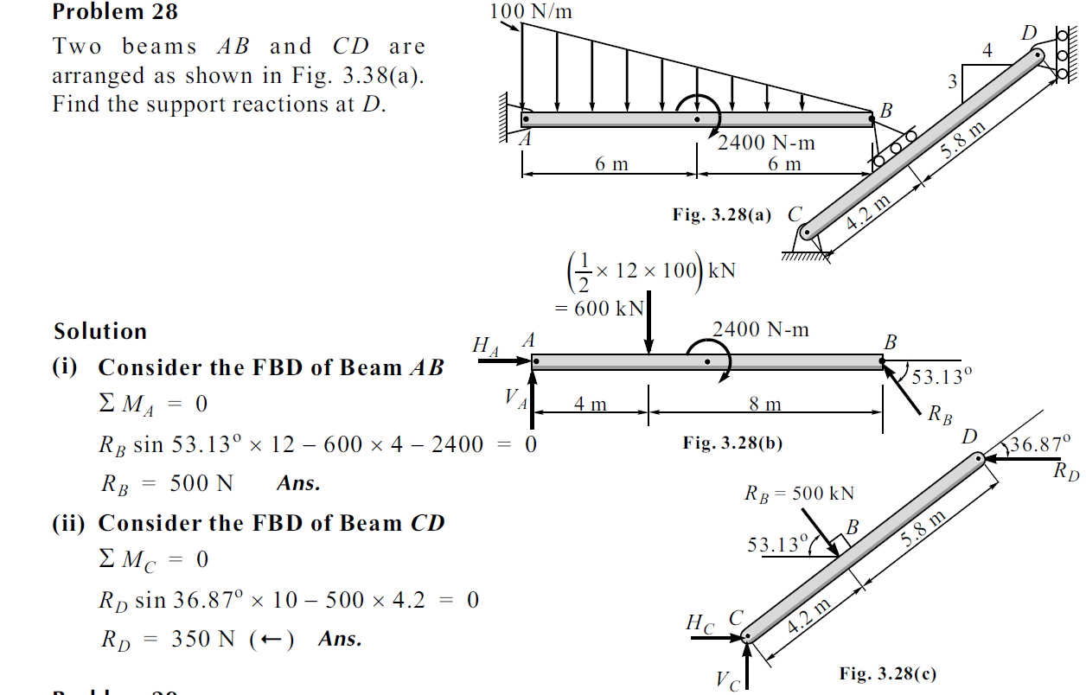

Slide 65
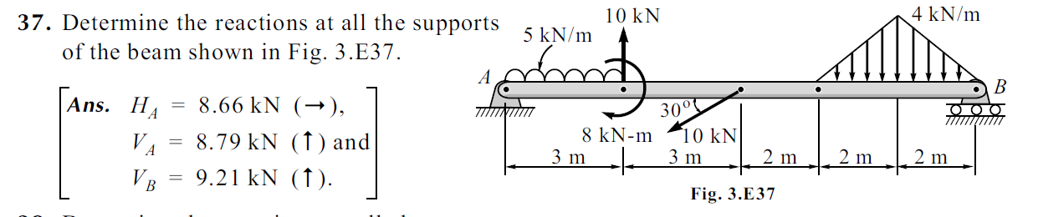
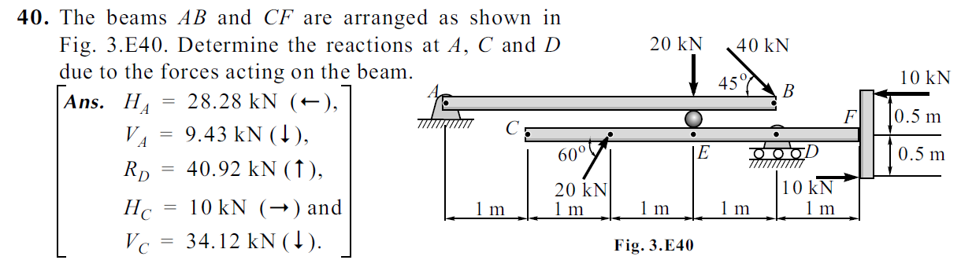

Slide 66
CABLES

Slide 67
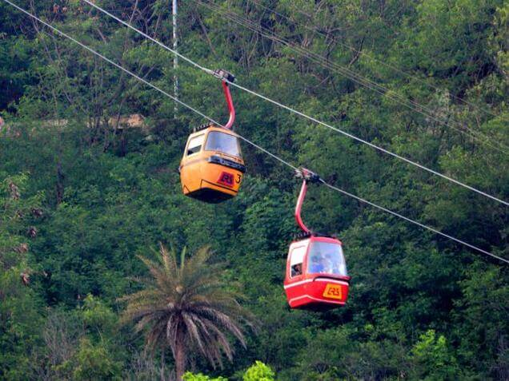
Rope way or Cable car or sky tram

Slide 68
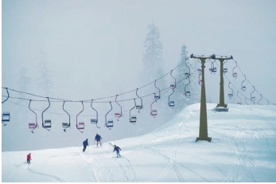

Slide 69
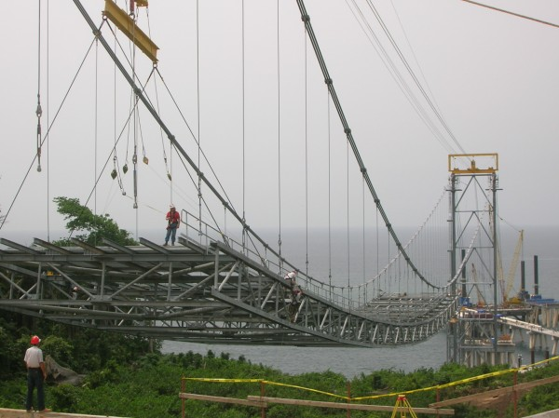

Slide 70

Consider a cable attached to two fixed points A and B and supporting n vertical concentrated loads P1, P2, . . . , Pn (Fig. 7.13a). We assume that the cable is flexible, i.e., that its resistance to bending is small and can be neglected. We further assume that the weight of the cable is negligible compared with the loads supported by the cable.
Any portion of cable between successive loads can therefore be considered as a two-force member, and the internal forces at any point in the cable reduce to a force of tension directed along the cable.

Slide 72


Slide 73

H_{A}
V_{A}
H_{B}
V_{B}
ΣFx = 0 , ΣFy = 0, ΣM = 0
ΣMC₂ = 0

Slide 74

Three loads are suspended as shown from the cable ABCDE. Knowing that d_{C}= 4 m, determine (a) the components of the reaction at E.

Slide 75
H_{A}
H_{E}
V_{A}
V_{E}
ΣFx = 0 , ΣFy = 0, ΣM = 0
ΣM_{A} = 0 (anticlockwise moment +ve)
(2 x 5) – (4 x 10) – (6 x 15) + (V_{E} x 20 ) = 0
V_{E} = (10+40+90)/20 = 140/20 = 7 kN

Slide 76
H_{A}
H_{E}
= 4m
V_{A}
V_{E} = 7 kN
Considering free body of the entire cable
ΣM_{C} = 0 (anticlockwise moment +ve)
(6 x 5) + (V_{E} x 10 ) - (H_{E} x d_{c} ) = 0
(30) + (7 x 10) - (H_{E} x 4) = 0
H_{E} = (-30+70)/4 = 40/4 = 10 kN

Slide 77
Determine the tension in each segment of the cable shown in figure below. Also obtain the elevation of points B and D.
V_{A}
V_{E}
2 m
3 m
1 m
2 m
H_{A}
A
H_{E}
E
y_{B}
y_{D}
11.5m
B
D
C
8 kN
8 kN
16 kN

Slide 78
V_{A}
V_{E}
A
2 m
3 m
1 m
2 m
H_{A}
H_{E}
E
y_{B}
y_{D}
V_{A}
11.5m
B
H_{A}
A
D
θ_{AB}
C
F_{DE}
8 kN
D
F_{AB}
8 kN
θ_{DE}
Joint A
θ_{CD}
16 kN
F_{DC}
F_{BA}
8 kN
θ_{AB}
B
F_{CB}
F_{CD}
Joint D
θ_{BC}
θ_{BC}
θ_{CD}
F_{BC}
C
8 kN
16 kN
Joint B
Joint C

Slide 79
V_{A}
V_{E}
2 m
3 m
1 m
2 m
H_{A}
A
H_{E}
E
y_{B}
y_{D}
11.5m
B
D
C
8 kN
8 kN
16 kN
Considering free body of the entire cable
ΣFy = 0 (upward forces + ve)
V_{A} - 8 – 16 - 8 + V_{B} = 0, V_{A} + V_{B} = 32 kN
ΣM_{A} = 0 (anticlockwise moment +ve)
(8 x 2) – (16 x 5) – (8 x 6) + (V_{E} x 8 ) = 0
V_{E} = (16+80+48)/8 = 144/8 = 18 kN
V_{A} = 32 – 18 = 14 kN
ΣFx = 0 (forces moving towards right side + ve)
- H_{A} + H_{B} = 0 kN, H_{A} = H_{B}

Slide 80
V_{A}
V_{E}
2 m
3 m
1 m
2 m
H_{A}
A
H_{E}
E
y_{B}
y_{D}
11.5m
B
D
8 kN
C
8 kN
16 kN
Considering free body of the left side of joint C
ΣM_{C} = 0 (anticlockwise moment +ve)
+(8 x 3) – (V_{A} x 5) + (H_{A} x 11.5) = 0
+(8 x 3) – (14 x 5) + (H_{A} x 11.5) = 0
H_{A} = (-24+70)/11.5 = 46/11.5 = 4 kN
ΣFx = 0 (forces moving towards right side + ve)
- H_{A} + H_{B} = 0 kN, H_{A} = H_{B} = 4 kN

Slide 81
Considering free body diagram of joint A
V_{A}
A
H_{A}
θ_{AB}
F_{AB}
ΣFx = 0 (forces moving towards right side + ve)
H_{A} + F_{AB} cosθ_{AB} = 0
4 + F_{AB} cosθ_{AB} = 0,
F_{AB} cosθ_{AB} = 4 kN _________(i)
ΣFy = 0 (Upward forces + ve)
+ V_{A} - F_{AB} sinθ_{AB} = 0,
+ 14 - F_{AB} sinθ_{AB} = 0,
F_{AB} sinθ_{AB} = 14 kN_______(ii)
After solving (i) & (ii) we get,
F_{AB} = 14.56 kN, θ_{AB} = 74.05◦

Slide 82

θ_{AB} = 74.05◦
^{y}_{B} ^{= 2 tan} θ_{AB} = 2 tan(74.05) = 7 m

Slide 83
F_{BA} = 14.56 kN
Considering free body diagram of joint B
θ_{BA} = 74.05
B
θ_{BC}
F_{BA} = 14.56 kN, θ_{BA} = 74.05◦
F_{BC}
8 kN
Joint B
ΣFx = 0 (forces moving towards right side + ve)
F_{BA} cosθ _{BA} + F_{BC} cosθ _{BC} =0
(14.56)cos(74.05) + F_{BC} cosθ _{BC} = 0,
F_{BC} cosθ _{BC} = 4 kN _________(i)
ΣFy = 0 (Upward forces + ve)
+ F_{BA} sinθ _{BA} - 8 - F_{BC} sinθ _{BC} =0
14.56 sin(74.05) - 8 - F_{BC} sinθ _{BC} =0
14- 8 - F_{BC} sinθ _{BC} =0, F_{BC} sinθ _{BC} =14-8 = 6 kN_______(ii)
After solving (i) & (ii) we get,
F_{BC} = 7.21 kN, θ_{BC} = 56.31◦

Slide 84
Considering free body diagram of joint C
F_{CB}
F_{CD}
θ_{CB}
θ_{CD}
F_{CB} = 7.21 kN, θ_{BC} = 56.31◦
C
16 kN
Joint C
ΣFx = 0 (forces moving towards right side + ve)
F_{CB} cosθ_{CB} + F_{CD} cosθ_{CD} =0
(7.21)cos(56.31) + F_{CD} cosθ_{CD} = 0,
F_{CD} cosθ_{CD} = 4 kN _________(i)
ΣFy = 0 (Upward forces + ve)
+ F_{CB} sinθ_{CB} + F_{CD} sinθ_{CD} =0
(7.21)sin(56.31) – 16 + F_{CD} sinθ_{CD} = 0,
6 - 16 + F_{CD} sinθ_{CD} =0, F_{CD} sinθ_{CD} =16-6 = 10 kN_______(ii)
After solving (i) & (ii) we get,
F_{CD} = 10.77 kN, θ_{CD} = 68.20◦

Slide 85
F_{DE}
Considering free body diagram of joint D
D
θ_{DE}
θ_{DC}
F_{DC} = 10.77 kN, θ_{DC} = 68.20◦
F_{DC}
8 kN
Joint D
ΣFx = 0 (forces moving towards right side + ve)
F_{DC} cosθ_{DC} + F_{DE} cosθ_{DE} =0
(10.77)cos(68.20) + F_{DE} cosθ_{DE} = 0,
F_{DE} cosθ_{DE} = 4 kN _________(i)
ΣFy = 0 (Upward forces + ve)
F_{DC} sinθ_{DC} - 8 + F_{DE} sinθ_{DE} =0
(10.77)sin(68.20) - 8 + F_{DE} sinθ_{DE} = 0,
-10 - 8 + F_{DE} sinθ_{DE} =0, F_{DE} sinθ_{DE} =18 kN_______(ii)
After solving (i) & (ii) we get,
F_{DE} = 18.44 kN, θ_{DE} = 77.47◦

Slide 86

θ_{DE} = 77.47◦
^{y}_{D} ^{= 2 tan} θ_{DE} = 2 tan(77.47) = 9 m

Slide 87



Slide 88
V_{A} =18.57 kN, H_{A} = 21.429 kN
V_{E} = 1.429 kN, H_{E} = 21.429 kN
d_{B} = 1.733 m, d_{D}= 4.20 m

Slide 89



Slide 90
V_{D}
V_{A}
H_{A}
H_{D}
25x9.81 =245.25 N
70x9.81 =686.7 N
Considering free body of the entire cable
ΣM_{A} = 0 (anticlockwise moment +ve)
(686.7 x 4) – (245.25x 10) – (P x 5) + (V_{D} x 14 ) = 0
14V_{D} - 5P= (2746.8+2452.5) = 5199.3 N
14 V_{D} – 5 P = 5199.3 N--------------(1)

Slide 92
V_{D}
V_{A}
H_{A}
H_{D}
25x9.81 =245.25 N
70x9.81 =686.7 N
Considering free body of the entire cable
ΣM_{A} = 0 (anticlockwise moment +ve)
(686.7 x 4) – (245.25x 10) – (P x 5) + (V_{D} x 14 ) = 0
14V_{D} - 5P= (2746.8+2452.5) = 5199.3 N
14 V_{D} – 5 P = 5199.3 N--------------(1)

Slide 93

V_{D}
V_{A}
H_{A}
H_{D}
Taking section from joint not cutting any members
25x9.81 =245.25 N
70x9.81 =686.7 N
Considering free body of the right side of joint B
ΣM_{B} = 0 (anticlockwise moment +ve)
– (245.25x 6) + (V_{D} x 10 ) - (H_{D} x 5 ) = 0
10V_{D} - 5 H_{D} = 1471.5 N --------------(2)

Slide 94

V_{D}
V_{A}
H_{A}
H_{D}
25x9.81 =245.25 N
70x9.81 =686.7 N
Considering free body of the right side of joint C
ΣM_{C} = 0 (anticlockwise moment +ve)
+ (V_{D} x 4 ) - (H_{D} x 3 ) = 0
4 V_{D} = 3 H_{D}
V_{D} = (3/4) H_{D} --------------(3)

Slide 95
14 V_{D} – 5 P = 5199.3 N--------------(1)
10V_{D} - 5 H_{D} = 1471.5 N --------------(2)
V_{D} = (3/4) H_{D} --------------(3)
10V_{D} - 5 H_{D} = 1471.5 N
10 (3/4) H_{D} - 5 H_{D} = 1471.5 N
7.5H_{D} - 5 H_{D} = 1471.5 N
(2.5) H_{D} = 1471.5 N
H_{D} = 588.6 N
V_{D} = (3/4) H_{D}
V_{D} = (3/4) 588.6 = 441.45 N
14 V_{D} – 5 P = 5199.3
14 (441.45) – 5P = 5199.3
6180.3– 5P = 5199.3
6180.3– 5199.3 = 5P
P = 196.2 N

Slide 96

3 m
P = 72 kN, Q = 30 kN

Slide 97



Slide 98


Slide 99




Slide 100



